Slide 1
Design and Analysis of Algorithms
Algorithms-II : CS345A
Lecture 4
Divide and Conquer Paradigm - III
Convex Hull
Algorithm to multiply 2 polynomials

Slide 2
problem 3
Convex Hull

Slide 3
A Convex Polygon
Definition: A polygon is convex if for any two points belonging to the polygon,
the line segment joining them is inside the polygon.
$p$
$q$

Slide 4
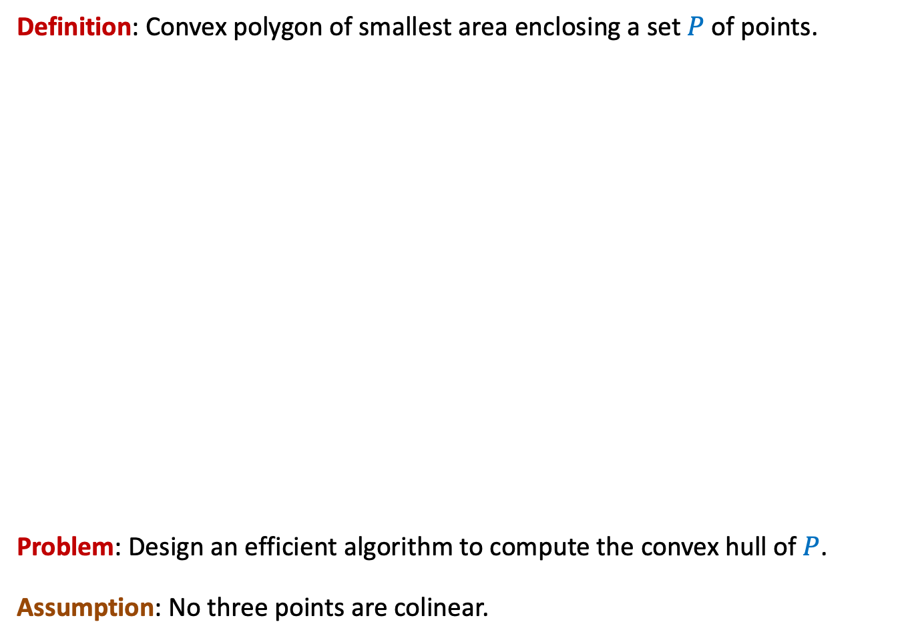
Convex hull
Definition: Convex polygon of smallest area enclosing a set $P$ of points.
Problem: Design an efficient algorithm to compute the convex hull of $P$.
Assumption: No three points are colinear.

Slide 5
Convex hull
Definition: Convex polygon of smallest area enclosing a set $P$ of points.
Problem: Design an efficient algorithm to compute the convex hull of $P$.
Assumption: No three points are colinear.

Slide 6
Convex hull
Definition: Convex polygon of smallest area enclosing a set $P$ of points.
Problem: Design an efficient algorithm to compute the convex hull of $P$.
Assumption: No three points are colinear.

Slide 7
Convex hull
Definition: Convex polygon of smallest area enclosing a set $P$ of points.
Problem: Design an efficient algorithm to compute the convex hull of $P$.
Assumption: No three points are colinear.

Slide 8
Tool 1
Let $A⊆P$.
Convex Hull of $A$ must be fully contained inside the convex hull of $P$.

Slide 9
Tool 2
Given a non-vertical line $L$ and a point $p$=($x_{1},y_{1}$), how to determine
whether $p$ lies above $L$ or below $L$?
Corollary: Given two points and a line $L$, it takes $O(1)$ time to determine
whether they lie on the same side or different sides of $L$.
$O(1)$ time
$$q=(a_{1},b_{1})$$
$$y=mx+c$$
$$r=(a_{2},b_{2})$$

Slide 10
Convex hull
…

Slide 11
Convex hull

Slide 12
Convex hull

Slide 13
Convex hull

Slide 14

Convex hull
Homework:
Prove the correctness of the algorithm.
O($n^{2}$) time

Slide 15
Divide and Conquer algorithm
Convex Hull

Slide 16



The Divide Step
O($n$) time
Left half set
$⌈\frac{n}{2}⌉$points
$⌊\frac{n}{2}⌋$points
Right half set

Slide 17

Solving the subproblems recursively
2 T($\frac{n}{2}$) time
Left half set
$⌈\frac{n}{2}⌉$points
$⌊\frac{n}{2}⌋$points
Right half set

Slide 18
The Conquer step
Left half set
$⌈\frac{n}{2}⌉$points
$⌊\frac{n}{2}⌋$points
Right half set

Slide 19
The Conquer step
Left half set
$⌈\frac{n}{2}⌉$points
$⌊\frac{n}{2}⌋$points
Right half set

Slide 20
A simpler problem
The right half set is a point

Slide 21

The right half set is a point
$$p$$

Slide 22


The right half set is a point
Tool 1
$$q$$
Upper tangent
$$p$$
Lower tangent
$$r$$

Slide 23
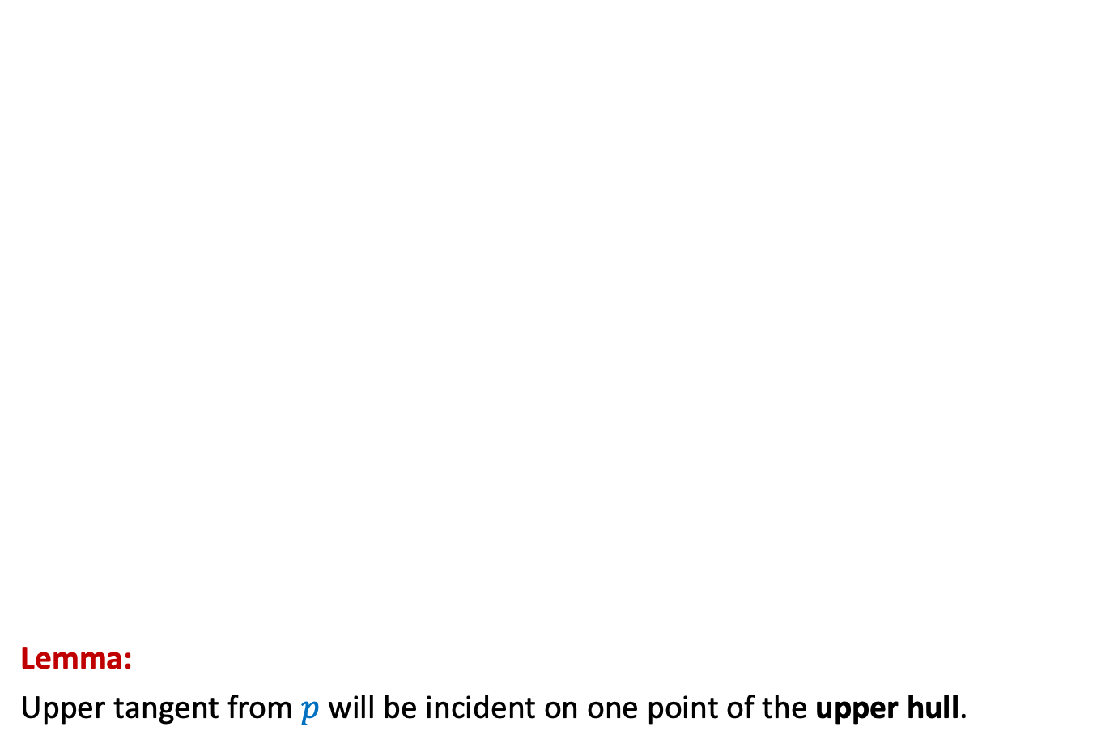
The right half set is a point
Lemma:
Upper tangent from $p$ will be incident on one point of the upper hull.
Upper Hull
Upper tangent
$$p$$
$$p$$

Slide 24
The right half set is a point
Lemma:
Lower tangent from 𝑝 will be incident on one point of the Lower hull.
$$p$$
$$p$$
Lower tangent
Lower Hull

Slide 25
How to compute the upper tangent ?
$$p$$

Slide 26







How to compute the upper tangent ?
Tool 2
O($n$) time to find upper tangent
$$s$$
$$w$$
$$q$$
$$u$$
Can’t we improve this this time complexity ?
$$t$$
$$p$$
$$r$$
Indeed, using careful insight in the convex hull structure. ☺
Watch the next slides slowly and attentively

Slide 27




How to compute the upper tangent ?
$$r$$ | $$u$$ | $$q$$ | $$s$$ | $$w$$ | $$t$$
$$s$$
$$q$$
Consider successor of $s$
$$w$$
$$u$$
$$t$$
$$p$$
$$r$$
Using convexity of the hull, show that
Continuing like this …
we can discard all points of upper hull that follow $s$
$q$ lies above line ($p$,$w$).
the other neighbor of $w$ (in this case $t$) lies below line ($p$,$w$).

Slide 28



How to compute the upper tangent ?
$$r$$ | $$u$$ | $$q$$ | $$s$$ | $$w$$ | $$t$$
$$s$$
$$q$$
Consider predecessor of $u$
$$w$$
$$u$$
$$t$$
$$p$$
$$r$$
Using convexity of the hull, show that
each point of the upper hull that precedes $u$
can not form upper tangent from $p$.

Slide 29



How to compute the upper tangent ?
We perform binary search on the upper hull to find the upper tangent from $p$
$$r$$ | $$u$$ | $$q$$ | $$s$$ | $$w$$ | $$t$$
$$s$$
Does it remind you something “very basic” you learnt in the past ?
$$w$$
$$q$$
Upper tangent
$$t$$
$$p$$
$$r$$
Binary Search
O(log $n$) time to find upper tangent

Slide 30
Going back to the original problem
Conquer Step

Slide 31

The Conquer step
Upper tangent
Lower tangent
$\frac{n}{2}$points
$\frac{n}{2}$points

Slide 32






How to compute the upper tangent ?
O($n$log $n$) time
$$w$$
$$x$$
$$v$$
$$u$$
$$y$$
$\frac{n}{2}$points
$\frac{n}{2}$points

Slide 33

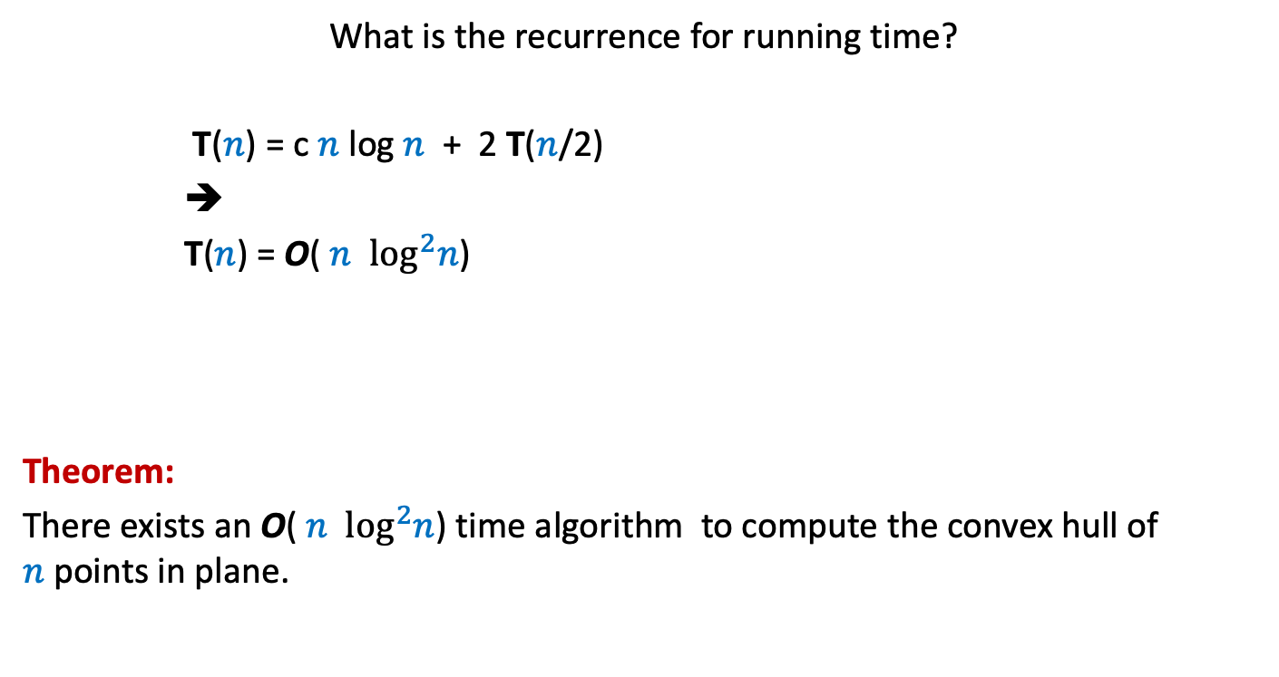
Running time of the algorithm
What is the recurrence for running time?
T($n$) = c $n$ log $n$ + 2 T($n$/2)
➔
T($n$) = O( $n$ $\log^{2}n$)
Theorem:
There exists an O( $n$ $\log^{2}n$) time algorithm to compute the convex hull of $n$points in plane.
c $n$

Slide 34
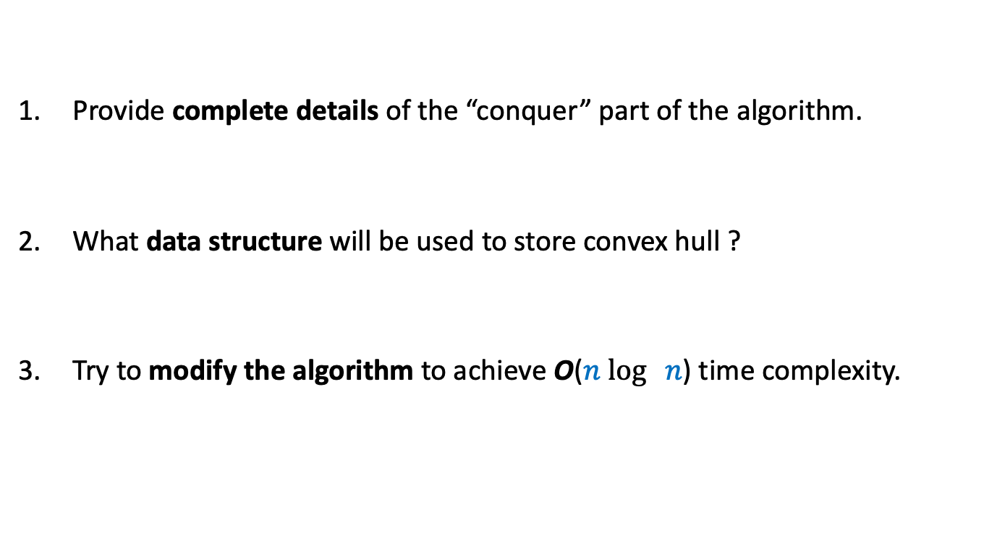
Homework
Provide complete details of the “conquer” part of the algorithm.
What data structure will be used to store convex hull ?
Try to modify the algorithm to achieve O($n$ $\log{ n}$) time complexity.

Slide 35
An algorithm for multiplying two polynomials
Problem 4

Slide 36
Multiplying two polynomials
Definition (polynomial of degree less than $n$)
$$A\left(x\right)=a_{0}+a_{1}x+a_{2}x^{2}+ …a_{n−1}x^{n−1}$$
Problem : Given two polynomial of degree less than $n$,
$$A\left(x\right)=a_{0}+a_{1}x+a_{2}x^{2}+ …a_{n−1}x^{n−1}$$
$$B\left(x\right)=b_{0}+b_{1}x+b_{2}x^{2}+ …b_{n−1}x^{n−1}$$
Compute $C=A × B$
$$C\left(x\right)=\sum_{0≤i<2n−1}{c_{i}x^{i}}$$
where $c_{i}$ =
Trivial algorithm: O( $n^{2}$)
Aim: O( $n$ $\log{n}$)
Applications:
Signal processing (Discrete Fourier Transform)
As practical as sorting and searching
Multiplication of two integers.
$$a_{0}b_{i}+a_{1}b_{i−1}+a_{2}b_{i−2}+ …+a_{i−1}b_{1}+a_{i}b_{0}$$
O($i$) time

Slide 37

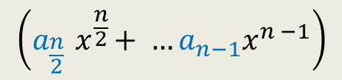


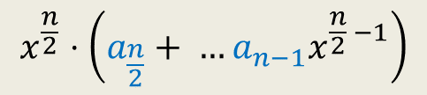

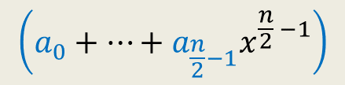

Divide Step
Attempt 1
$$A\left(x\right)=a_{0}+a_{1}x+a_{2}x^{2}+ …a_{n−1}x^{n−1}$$
$$A\left(x\right)= ? + ?$$
$$A\left(x\right)=A_{first}\left(x\right)+{ x}^{\frac{n}{2}} A_{second}\left(x\right)$$
$$\left(a_{0}+…+a_{\frac{n}{2}−1}x^{\frac{n}{2} −1}\right)$$
$$x^{\frac{n}{2}}⋅\left(a_{\frac{n}{2}}+ …a_{n−1}x^{\frac{n}{2} −1}\right)$$
$$\left(a_{\frac{n}{2}}{ x}^{\frac{n}{2}}+ …a_{n−1}x^{n −1}\right)$$
First $\frac{n}{2}$ terms of $A\left(x\right)$
Last $\frac{n}{2}$ terms of $A\left(x\right)$
$$A_{first}\left(x\right)$$
$$A_{second}\left(x\right)$$
Notes:
We can evaluate x^{n/2} in log n time for any given value of x: by repeated squaring:
For example, to compute x^1024, we compute and square x^512.
To compute x^512, we compute and square x^128.
To compute x^128, we copute and square x^64
…
To compute x^2, we square x.
So just O(log n) arithmetic operations are needed.

Slide 38

Homework for those aiming beyond A*
Design an $o(n^{2})$ time algorithm based on divide and conquer ?
Hint:
Recall ESO207

